Slide 1



SRI SIDDHARTHA INSTITUTE OF TECHNOLOGY
(A Constituent College of Sri Siddhartha Academy of Higher Education)
MARALUR, TUMAKURU-572105
Department of Computer Science And Engineering
MINI PROJECT
“ Predicting Covid cases in Maharashtra state
using Linear regression”
Project Associates:-
SHREYAS T M
VIVEK V R
THEJASWI K
VINOD S C
Guide Name :- Mr.Chennabasavaraju T P
Associate Professor, CSE Dept.
SSIT Tumakuru
Date :- 10/08/2021

Slide 2
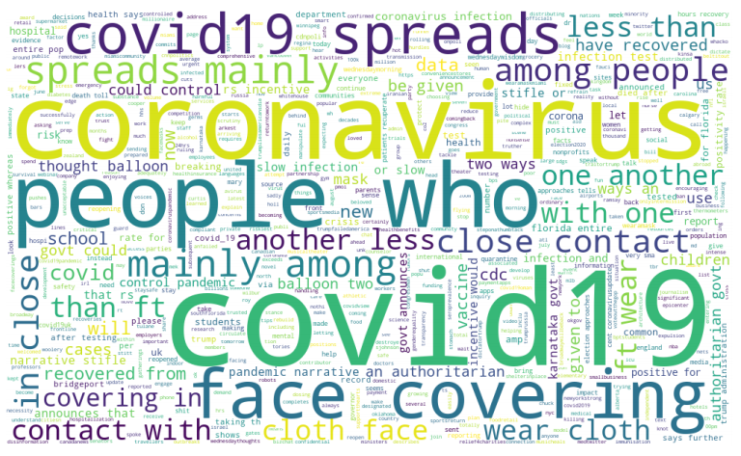
CONTENTS
Introduction
Literature Survey
Methodology
Output
Applications
Limitations
Conclusion
References

Slide 3
INTRODUCTION
At the end of December 2019 in Wuhan, China, it was first reported that a human infection was caused by a novel coronavirus (nCov) or Wuhan virus or 2019-nCov.
The coronavirus (COVID-19) infected cases increase at an exponential rate worldwide.
There are very less number of COVID-19 test kits available in hospitals which are not at all sufficient for the increasing cases.
Artificial Intelligence is actually dominant tool in the fight against the COVID-19 crisis. AI has subdomain like Machine Learning.
It helps in diagnose and predict COVID-19. ML Techniques are useful in tracking COVID cases and predicting.The aim of this project is to develop a prediction model to predict the covid cases.

Slide 4
LITERATURE SURVEY
1.Prediction using SVM:Published online 2021 May 21. .
A novel approach to predict COVID-19 using support vector machine by Soham Guhathakurata, and others. Achieved an accuracy of 87% in predicting the cases.
2.Prediction using KNN classifier:Published online September 2020.
A novel approach to predict COVID-19 using KNN classification by Vamsidhar Yendapalli ,and others. For the given dataset, the k-nearest neighbour (KNN) classification algorithm produces 80.4 % of predication accuracy and 1.5 to 3.3 % of improved accuracy over other algorithms.
3. Prediction using ANN classifier:Published online 23 November 2020. Article number: 50 (2020).
A novel approach to predict COVID-19 using ANN based model by Hamid Reza Niazkar and others. . The accuracy of this model is 84-87%.
4.Prediction using Linear regression:
In this project, linear regression model has been proposed for the prediction of COVID-19 peak in India and their states with the highest number of total cases. Further, short-term predictions have also been computed using this model, and the results are compared with the real world cases. The accuracy of this model is 89%.

Slide 5
METHODOLOGY
1.Data was collected in a CSV file and uploaded in Jupyter notebook and analysed with the Python 3.8.2 software.
Input: Total number of infected cases, active cases, recovery numbers.
Output: Predicted confirmed cases of a state.
2.As we are analyzing loads of data, we are trying to do it in a methodological approach by using the
following steps.
First, we imported the COVID19 dataset and prepared it for analysis by dropping columns and aggregating rows.
Choosing on and evaluating a good measure for our analysis.
Visualizing our analysis results using Matplotlib,Seaborn.

Slide 6
LINEAR REGRESSION
Linear regression may be defined as the statistical model that analyzes the linear relationship between a dependent variable with given set of independent variables.
Mathematically the relationship can be represented with the help of following equation ,Y = mX + b
Here, Y is the dependent variable we are trying to predict
X is the dependent variable we are using to make predictions.
m is the slop of the regression line which represents the effect X has on Y

Slide 7
Libraries used
Pandas
Numpy
Matplotlib
Sklearn
Seaborn

Slide 8
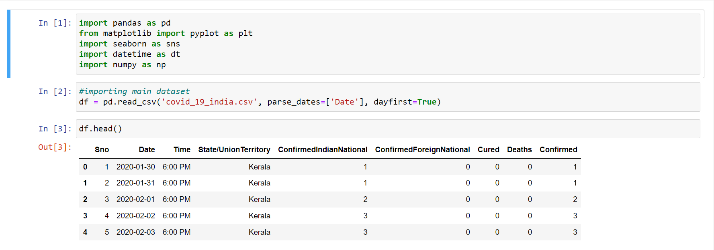
OUTPUT
Importing libraries and reading dataset.

Slide 9
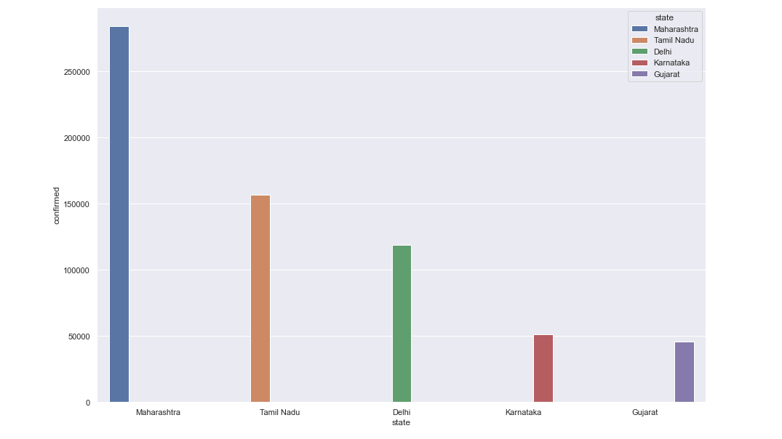
[2] Plotting a bar graph for top 5 states with maximum number of confirmed cases.

Slide 10
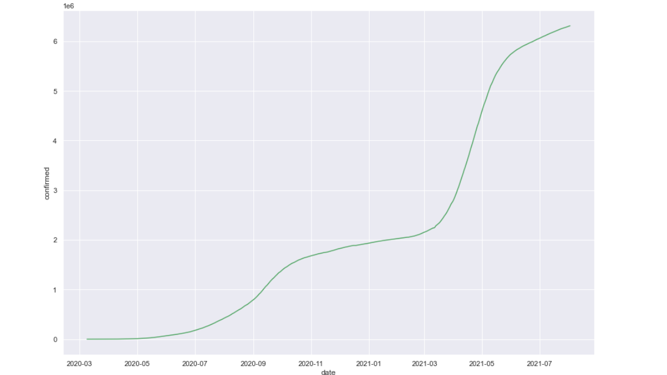
[3] Plotting a line graph for confirmed cases in Maharashtra.

Slide 11
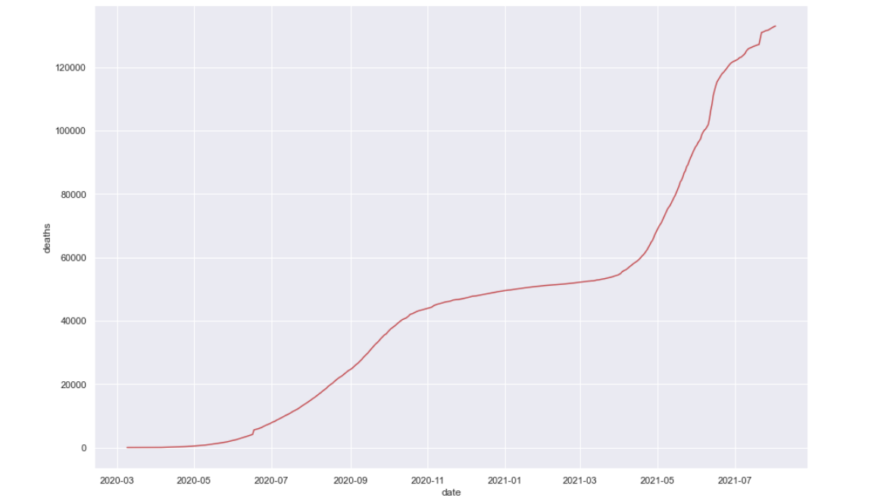
[4] Plotting a line graph for death cases in Maharashtra

Slide 12
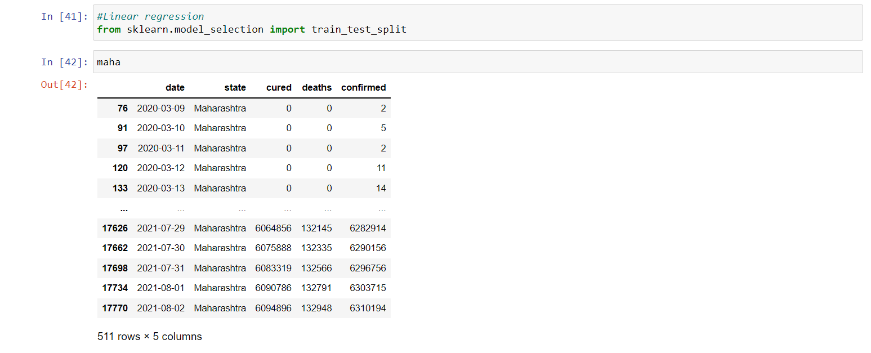
[5] Implementing linear regression using sklearn model.

Slide 13
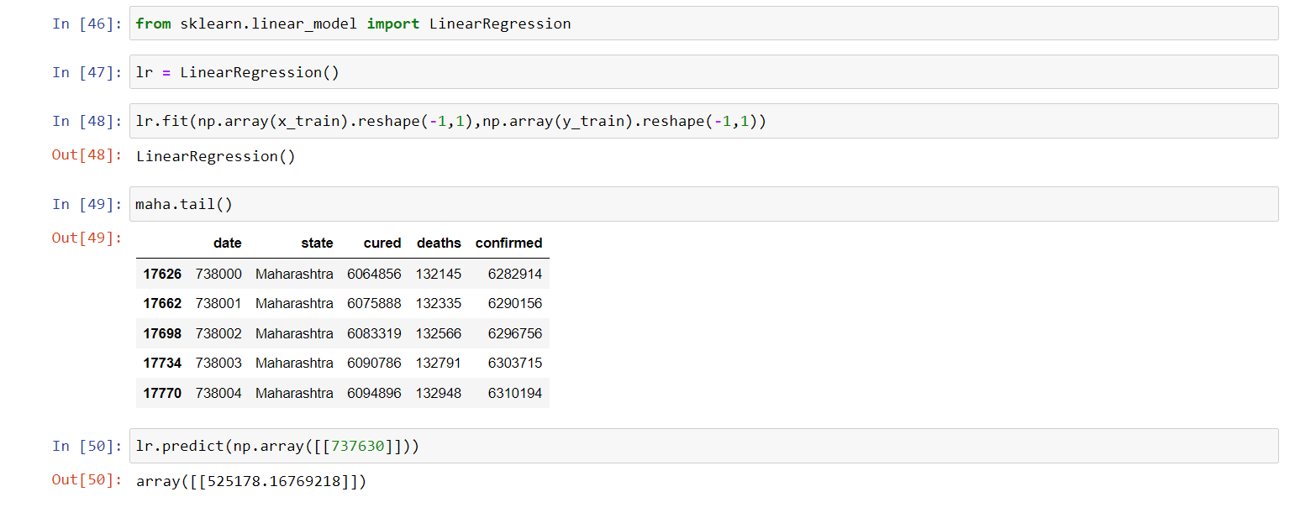
[6] Predicting the confirmed cases using linear regression.

Slide 14
APPLICATIONS
Provide an intelligent platform for healthcare.
Machine learning- AI is found as an emerging tool which shows their potential to fight against novel coronavirus disease.
Predict the number of confirmed cases in every state of India. We hope that such state wise predictions would help the state governments better channelize their limited health care resources.

Slide 15
LIMITATIONS
The main limitation of this analysis was that it takes more input data into consideration without taking into account the logistic actions being taken or not taken during the process. However, at the end of week results are highly indicative of both the virus-related natural trajectory as well as the local government’s reactions.
Secondly, limiting our analysis to the top 10 most infected states could lead to an over-estimation of the outcomes. However, faced with a catastrophe of such magnitude, it is worth over-estimating rather than under-estimating.

Slide 16
CONCLUSION
In this study, a linear regression model has been used for the COVID-19 predictions. A comparative study shows that it performs better than the other existing model and hence can be used for future prediction in better accuracy. In addition, we analyzed patterns with the confirmed, death, recovered cases. In the future, this study will be further continued with much more accurate algorithms and updated datasets.

Slide 17
REFERENCES
https://www.kaggle.com/sudalairajkumar/covid19-in-india
https://www.greatlearning.in/academy/learn-for-free/courses/predicting-covid-19-in-india-using-machine-learning
https://www.tutorialspoint.com/machine_learning_with_python/regression_algorithms_linear_regression.htm
reportCoronavirus disease (COVID-2019) situation reports. World Health Organization.Available at:: https://www.who./emergencies/diseases/novel-coronavirus-2019/situation-reports/[Accessed on: 26nd March 2020].
INDIA COVID-19 TRACKER. 2020. https://www.covidindia.org/ [Online] Available at: Accessed on: 26nd March 2020. [Google Scholar]
https://ghrp.biomedcentral.com/articles/10.1186/s41256-020-00175-y#Abs1

Slide 18


